Slide 1
Algebraic Expressions
The Number System
Geometry
Measurement and Data
Ratios and Proportions
10
10
10
10
10
20
20
20
20
20
30
30
30
30
30
40
40
40
40
40
50
50
50
50
50

Slide 2
Category 1 questions follow

Slide 3
Category 1
What is the value of x which makes the equation true?.
5x = 30
35
25
150
6
10

Slide 4
Category 1
D. 6
5x = 30
$÷$ 5 $÷$ 5
x = 6
check
5(6) = 30
10

Slide 5
Category 1
Please choose the correct answer for the problem below.
g + 50 = 75
125
25
75
15
20

Slide 6
Category 1
B. 25
g + 50 = 75
– 50 – 50
g = 25
check
25 + 50 = 75
20

Slide 7
Category 1
Please choose the correct answer for the problem below.
x – ( 26 + 4 ) = 65
95
30
35
98
30

Slide 8
Category 1
A. 95
x – ( 26 + 4 ) = 65
x – ( 30 ) = 65
+ 30 + 30
x = 95
check
95 – ( 26 + 4 ) = 65
95 – ( 30) = 65
30

Slide 9
Category 1
Please choose the correct answer for the problem below.
h ÷ 7 = 12
5
19
84
1.71
40

Slide 10
Category 1
C. 84
h ÷ 7 = 12
x 7 x 7
h = 84
check
84 ÷ 7 = 12
40

Slide 11
Category 1
Please choose the correct answer for the problem below.
( 109 – 84 ) x b = 50
75
2
25
1,250
50

Slide 12
Category 1
B. 2
( 109 – 84 ) x b = 50
( 25) x b = 50
÷ 25 ÷ 25
b = 2
check
( 109 – 84 ) x 2 = 50
( 25) x 2 = 50
50

Slide 13
Category 2 questions follow

Slide 14
Category 2
What is the greatest common factor for 10 and 12?
A. 1
B. 2
C. 4
D. 60
10

Slide 15
Category 2
B. 2
Factors 10: 2 x 5
Factors 12: 2 x 2 x 3
Greatest Common Factor: 2
10

Slide 16
What is the least common multiple for 6 and 14?
A. 2
B. 28
C. 84
D. 42
20

Slide 17
Category 2
D. 42
Multiples of 6: 12,18,24,30,36, 42
Multiples of 14: 14, 28, 42
Least Common Multiple: 42
20

Slide 18
Category 2
Points A (4, 8) and B (4, 18) are graphed points on a coordinate plane. What is the distance between these two points?
A. 0
B. 4
C. 14
D. 10
30

Slide 19
Category 2
D. 10
18 – 8 = 10
30

Slide 20
Category 2
A. 15
B. 5
C. 45
D. 0.02
40

Slide 21
Category 2
B. 5
40

Slide 22
Category 2
A. 24
B. 72
C. 2
D. 4
50

Slide 23
Category 2
C. 2
50

Slide 24
Category 3 questions follow

Slide 25
Category 3
Maria has a 3.5’ by 10’ rectangle shaped green tile. What is the area for this rectangle shaped green tile in square feet?
A. 2.86
B. 17.5
C. 35
D. 70
10

Slide 26
Category 3
C. 35
3.5 x 10 = 35
10

Slide 27
Category 3
Bob has a yellow cardboard triangle with a length of 6 centimeters and a height of 14 centimeters. What is the area of this right triangle in square centimeters?
A. 42
B. 21
C. 72
D. 84
20

Slide 28
Category 3
B. 42
20

Slide 29
Category 3
Joey has four triangle shaped mouse pads with the dimensions of 3” base x 4” height. The four triangle shaped mouse pads were placed together to form a diamond shape. What is the total area, in square inches, for the four triangle shaped mouse pads?
A. 12
B. 24
C. 48
D. 6
30

Slide 30
Category
B. 24
(3 x 4) x 4 = (12) x 4 = 6 x 4 = 24
$\frac{1}{2}$
$\frac{1}{2}$
30

Slide 31
Category 3
Mrs. Wilson cut a 8” by 4” cake exactly in half. She at the first half but left the second half for her sister. What is the area of the second half of cake in square inches?
A.
B. 18
C. 36
D. 9
40

Slide 32
Category 3
A. 16
(8x 4)/ 2 = (32)/2 = 16
40

Slide 33
Category 3
Samantha cuts three 8” by 12” triangles out of construction paper. What is the total area of all three triangles in square inches?
A. 48
B. 96
C. 72
D. 144
50

Slide 34
Category 3
D. 144
50

Slide 35
Category 4 questions follow

Slide 36
Category 4
Please choose the correct answer to make the conversion below true.
___ pounds = 80 ounces
5
2
7
8
10

Slide 37
A. 5
1 pound = 16 ounces
5 pounds = 5(16)= 80 ounces
10

Slide 38
Category 4
Please choose the correct answer to make the conversion below true.
___fluid ounces = 8 cups
8
64
24
32
20

Slide 39
Category 4
B. 64
8 fluid ounces = 1 cup
8 x 8 = 64
20

Slide 40
Category 4
Please choose the correct answer to make the conversion below true.
___kilograms = 440 pounds
100
200
440
484
30

Slide 41
Category 4
B. 200
1 pound = 2.2 kilograms
440 $÷$ 2.2 = 200
30

Slide 42
Category 4
Please choose the correct answer to make the conversion below true.
___miles = 200 kilometers
A. 440
B. 90.91
C. 124
D. 600
40

Slide 43
Category 4
C. 124
0.62 miles = 1 kilometer
200 x 0.62 = 124
40

Slide 44
Category 4
Please choose the correct answer to make the conversion below true.
___ inches = 12 meters
A. 240
B. 354.33
C. 0.305
D. 472.44
50

Slide 45
Category 4
D. 472.44
39.37 inches = 1 meter
39.37 x 12 = 472.44
50

Slide 46
Category 5 questions follow

Slide 47
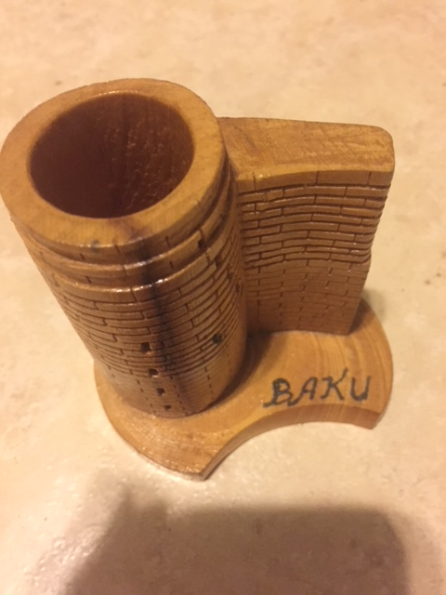
Category 5
William can carve 14 wooden figures in seven hours. How many wooden carvings can he make in twenty-one hours?
28
147
21
42
10

Slide 48
Category 5
D. 42
10

Slide 49
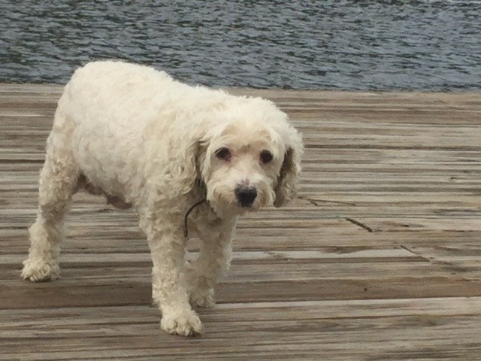
Category 5
Billy’s dog Fido walks eight yards in three hours. How far does Fido walk in yards in six hours?
A. 36
B. 4
C. 24
D. 16
20

Slide 50
Category 5
D. 16
20

Slide 51
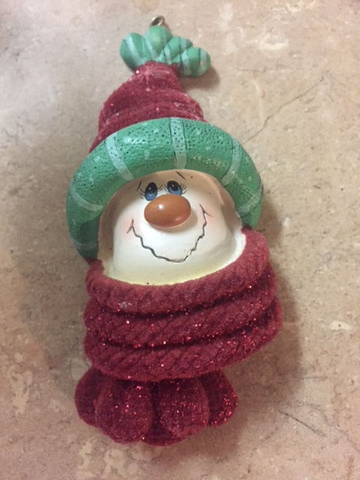
Category 5
A machine produces eighteen plastic snowmen every six seconds. Approximately, how many plastic snowmen will be made in 54 minutes?
A. 108
B. 324
C. 72
D. 40
30

Slide 52
Category 5
C. 72
30

Slide 53
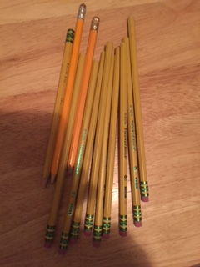
Category 5
A store sells a bag of twelve pencils for $1.32. What is the unit cost of a single pencil in the bag?
A. $0.32
B. $1.32
C. $0.22
D. $0.11
40

Slide 54
Category 5
D. $0.11 $1.32 $÷$ 12 = $0.11
40

Slide 55
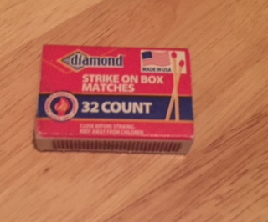
Category 5
Tony collects matchbooks since he works in a museum with a lot of candles. He keeps his favorite 16 matchbooks in a bag in his room. This is 25% of his collection. How many total matchbooks are in his collection?
A. 64
B. 8
C. 100
D. 4
50

Slide 56
Category 5
A. 64
16 $÷$ 0.25 = 64
Check
64 x 0.25 = 16
50

